Slide 1

Become a Power BI data modeling wizard using Tabular Editor 3

Slide 2
Agenda
Tabular Editor and Power BI Desktop better together
Improve your DAX
Making better data models, faster
TE as a Power BI External Tool
Advanced features
Debugging DAX
C# Scripting
Q&A

Slide 3




About us
Morten Lønskov Product Manager
David Bojsen
Architect
Works with support, documentation, content etc.
Danish, but lives in Hamburg
Many different tasks, code review, DevOps / CI/CD, content writing etc.
Lives in Denmark

Slide 4
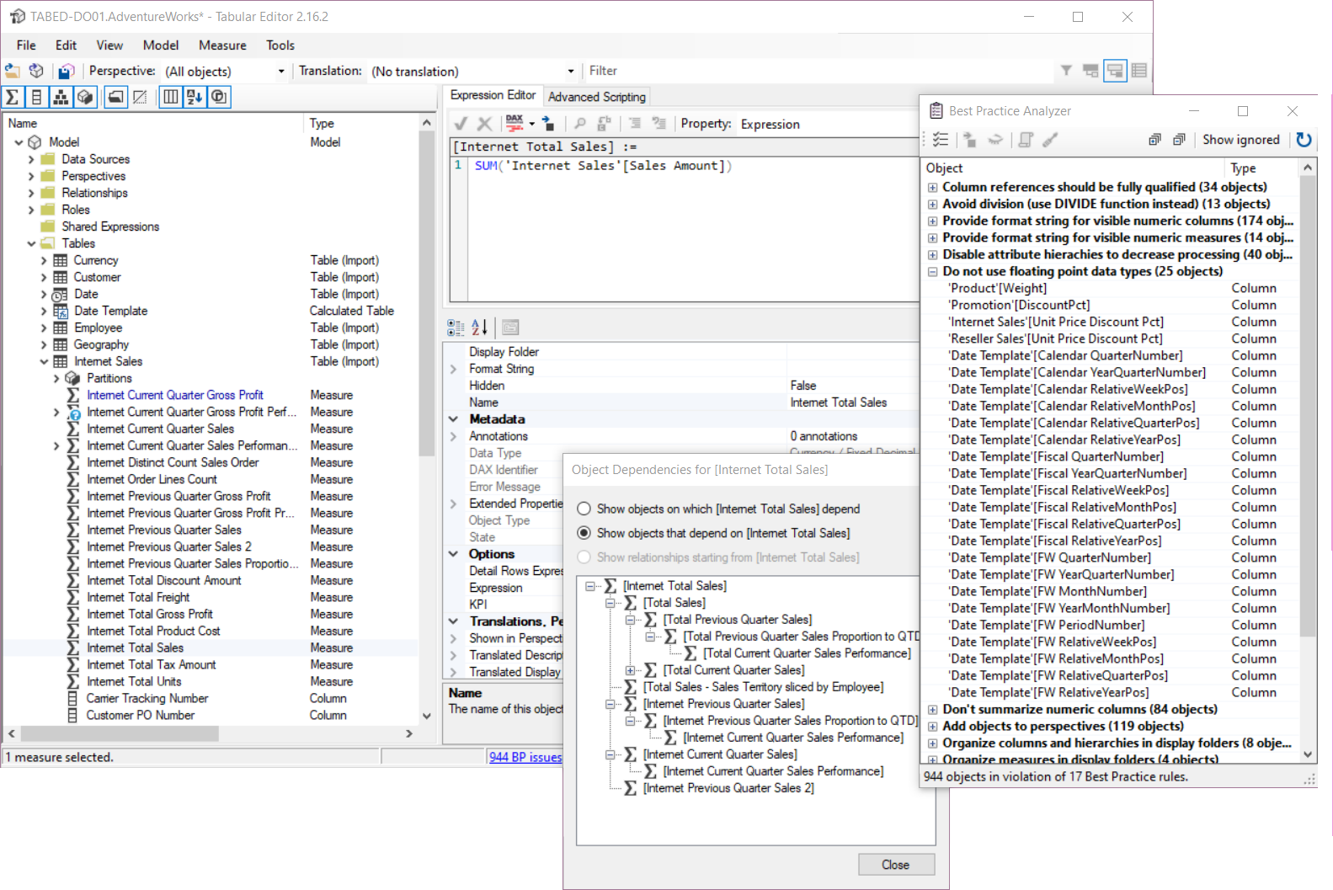
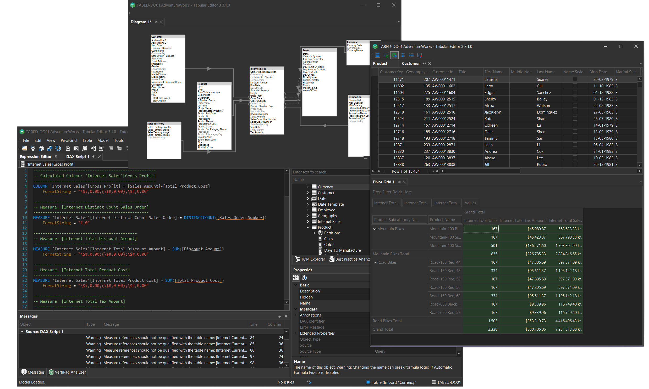
TE2 vs TE3
Tabular Editor 2
Open source & free
Tabular Editor 3
Commercial product

Slide 5
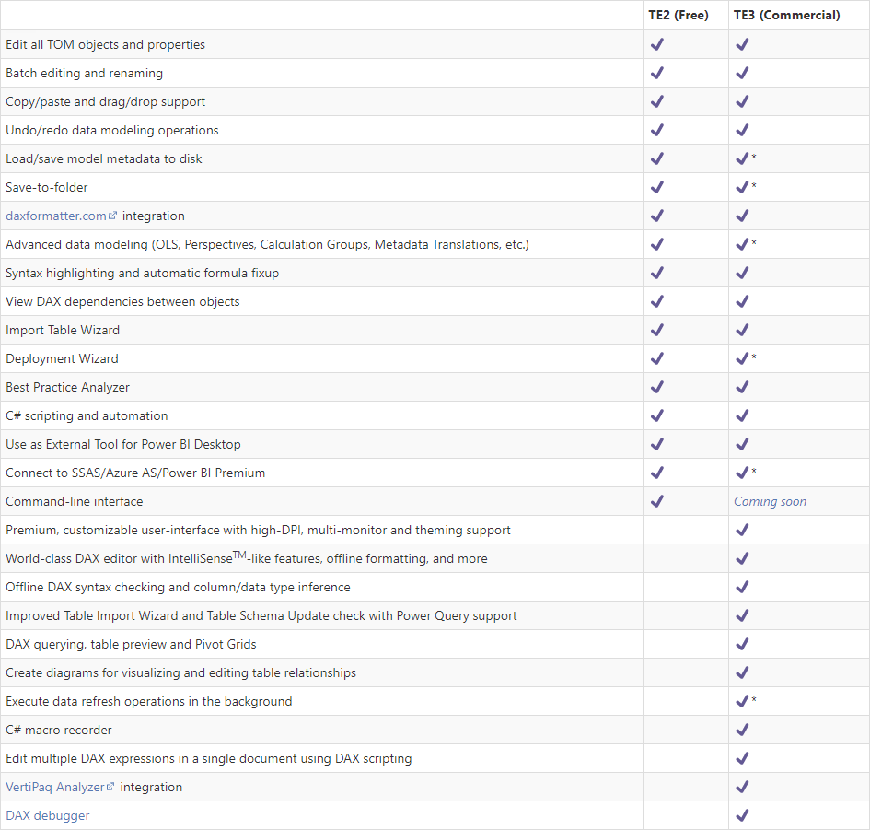
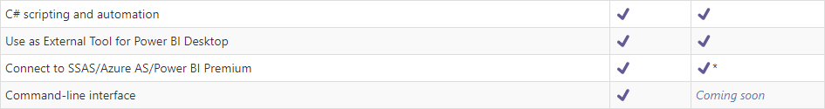
TE2 vs TE3

Slide 6


Tabular Editor and Power BI Desktop better together
Improve your DAX

Slide 7
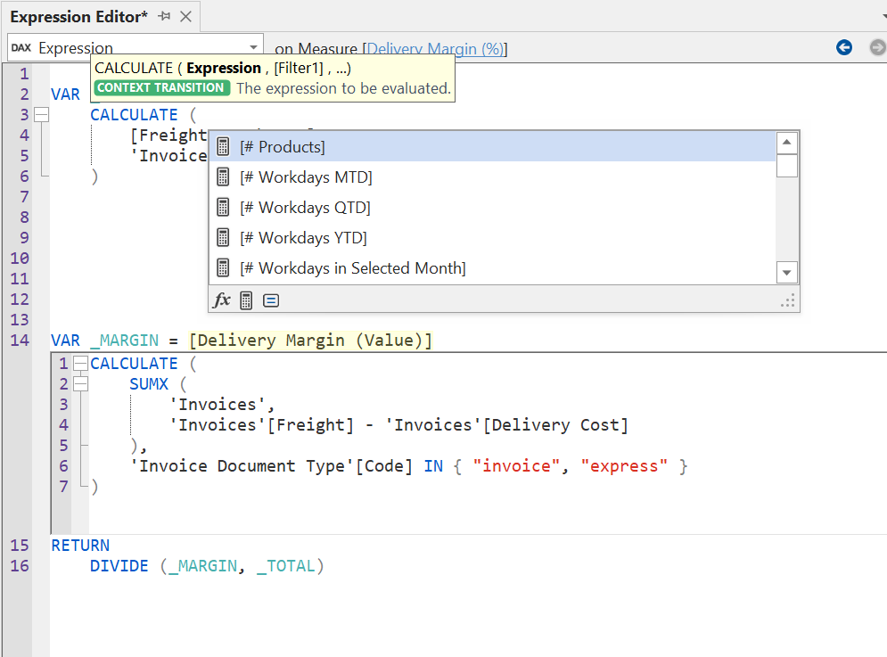




Improve your DAX
Write better DAX in less time
Code Assistance

Slide 8
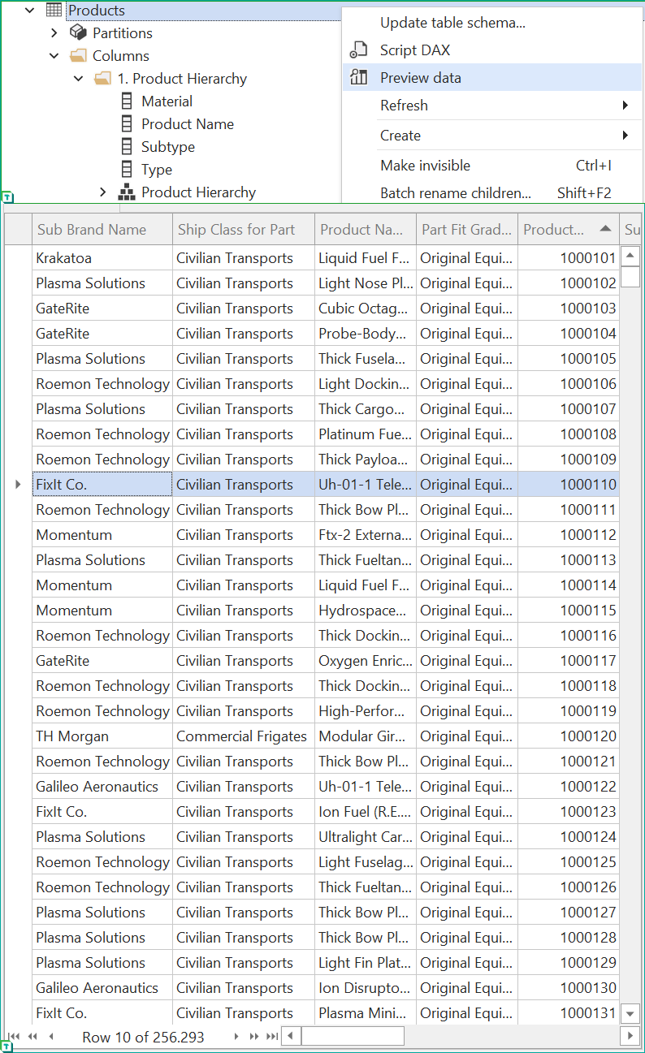
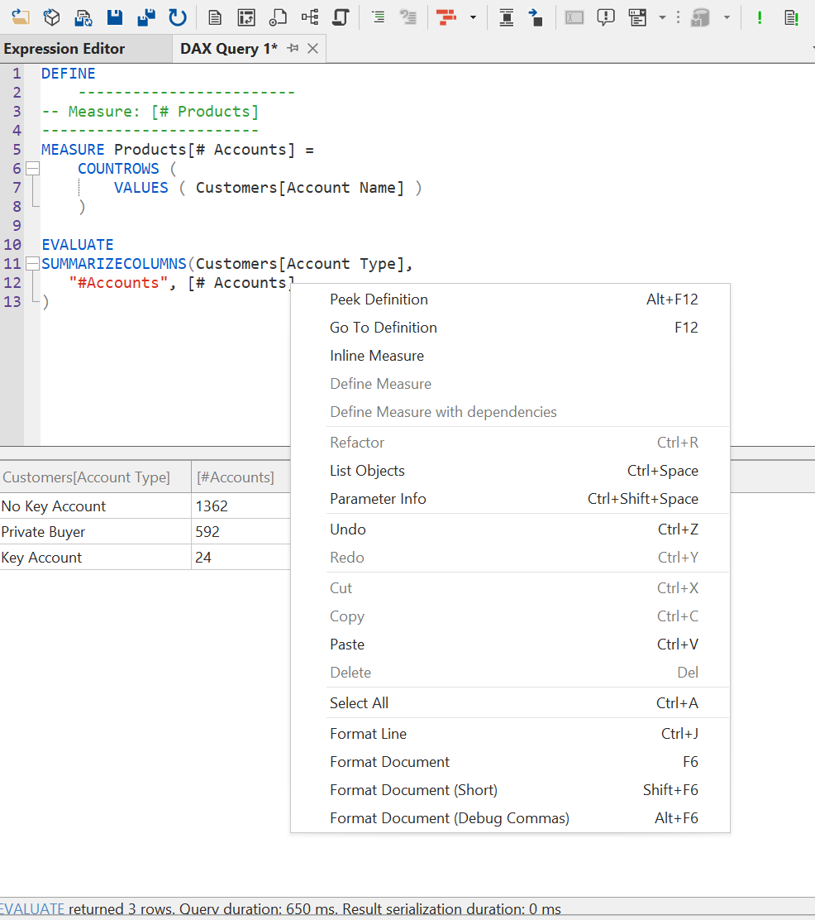
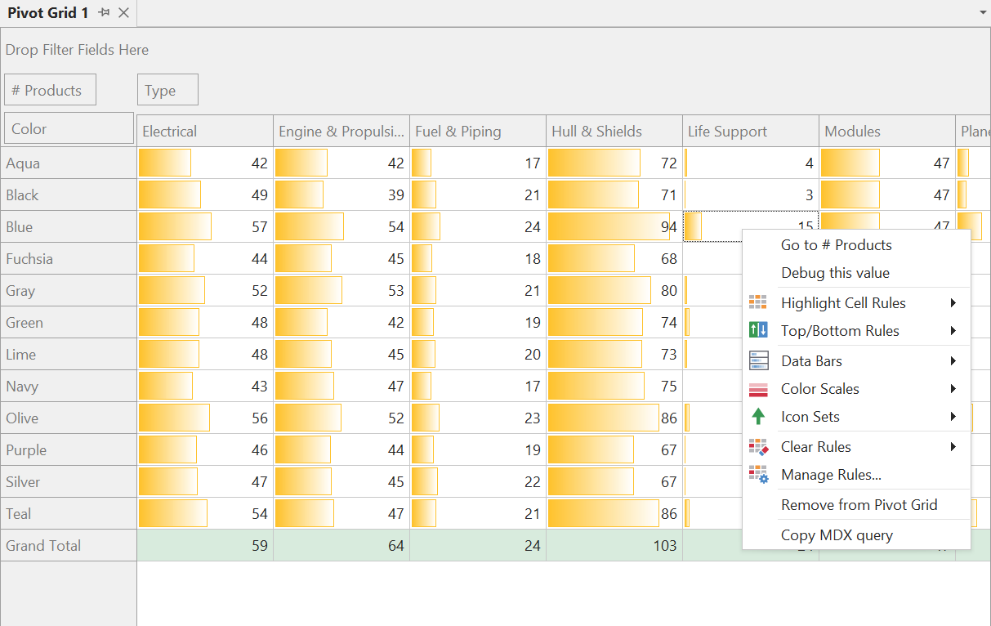



Improve your DAX
Validate & Explore Data
Preview your tables while DAXing
Seeing result in Pivot Grid
Use DAX queries
DAX

Slide 9
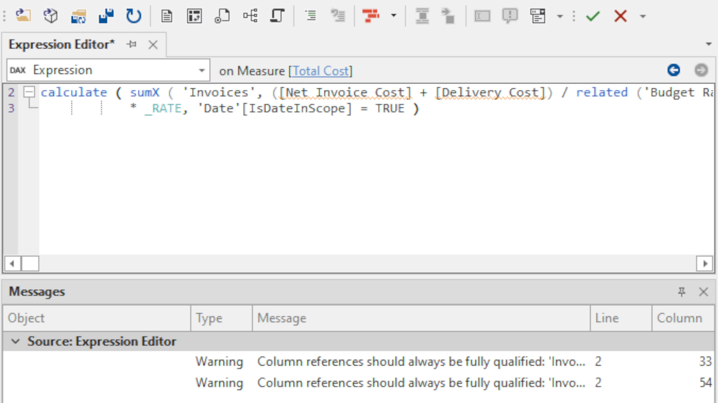




Improve your DAX
Automate & enhance productivity
Multitask -- Batch Tasking
Automate quality control, validation

Slide 10
Tabular Editor and Power BI Desktop better together
Making better data models, faster

Slide 11
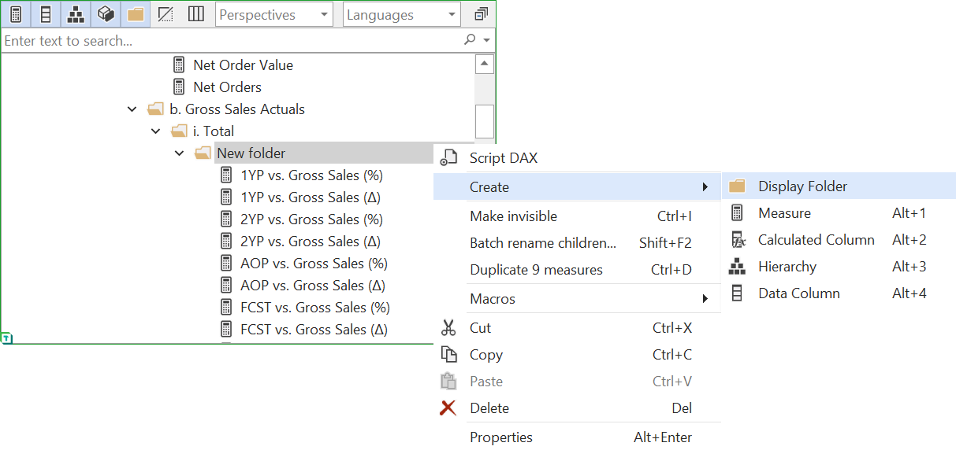


Making better data models, faster
Automate & enhance productivity
Multitask -- Batch Tasking

Slide 12
Making better data models, faster
The Best Practice Analyzer (BPA)
The BPA automatically scans the model
Checks if ‘Best Practice’ rules are met
Notifies of all instances where BPA rules are violated
Benefit
Saves time
Improves model quality

Slide 13
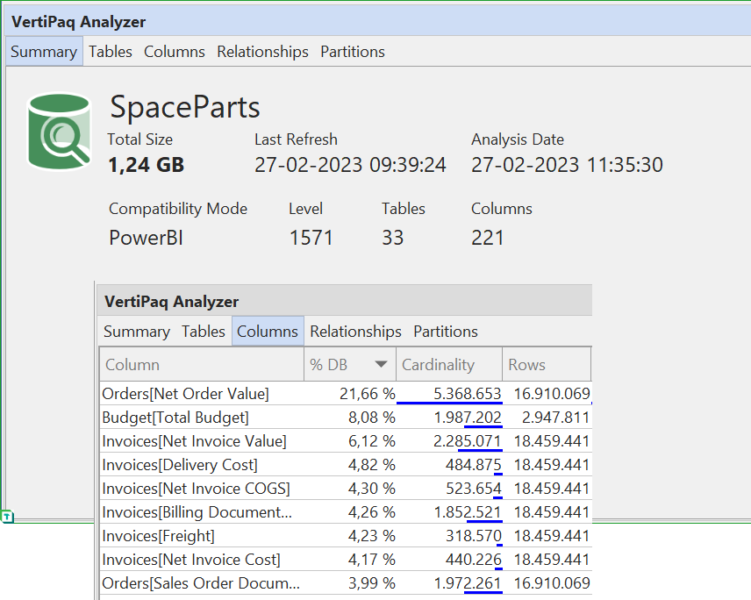

Making better data models, faster
Optimize data models
Analyze the model

Slide 15
Tabular Editor and Power BI Desktop better together
Debugging DAX

Slide 16
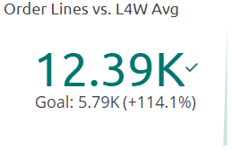
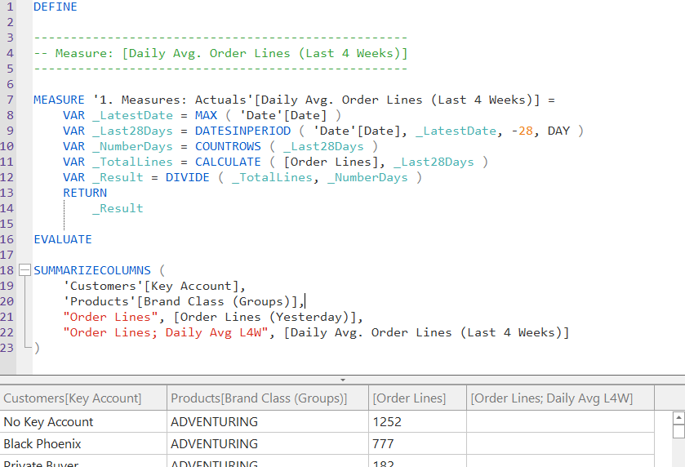
Debugging DAX
“This doesn’t look right” – Order Lines for Aug 19 vs 28D Avg
Trial & error
Changes in DAX code
Filters in Power BI report
Manual validations in Excel

Slide 17




Debugging DAX
Can feel like being lost in the wilderness
DAX Query
CALCULATE
ADDCOLUMNS
[Measure]

Slide 18





What the DAX Debugger Does
DAX Query
Breakdown & navigate DAX, step-by-step
[Measure]
Highlights & evaluates ‘landmark’ parts in code
Reveals context to show how results obtained
Watch other DAX as you navigate to investigate

Slide 19


What is the DAX Debugger?
DAX Query
DAX Map
Navigate the code steps to investigate specific areas
Compass
Check the filter and row context for how intermediate values are obtained
[Measure]
Debugger
+ Call Tree
Evaluation
Context
Landmarks
Check intermediate values to get your bearings as you navigate
Binoculars
Evaluate other model DAX as landmarks to investigate what’s going on
Locals
Watch

Slide 20
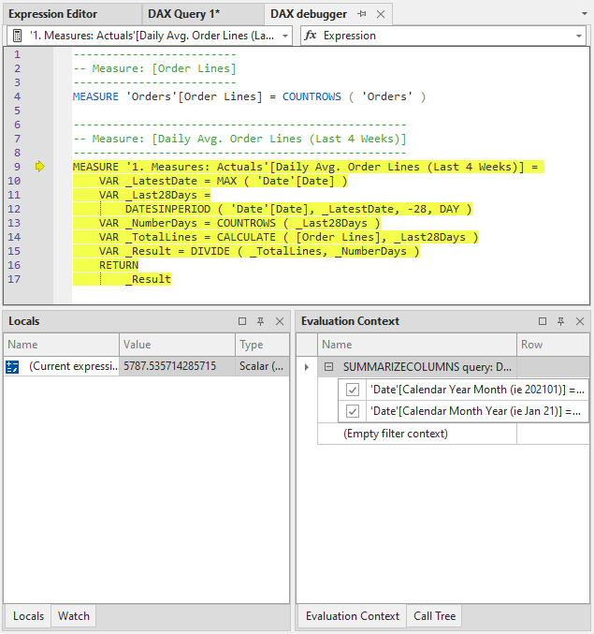
Debugger
Shows a Script of your DAX
View DAX expressions in the Query
Includes their dependencies
Highlights current evaluation
Steps through to evaluate part-by-part

Slide 22
Tabular Editor and Power BI Desktop better together
TE as a Power BI External Tool

Slide 23

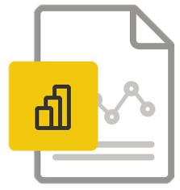

TE as a Power BI External Tool
1
Power BI Desktop
Tabular Editor
2
3

Slide 24
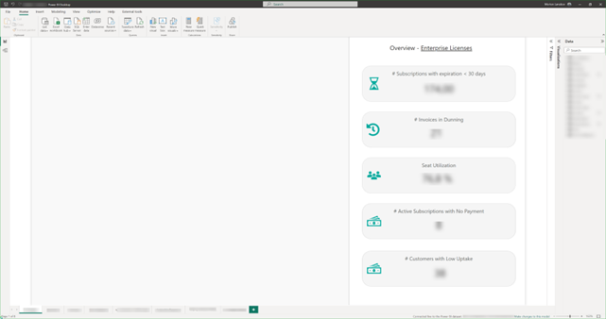

Considerations
Must be a data model, not a report
No live connection (“thin” reports or Analysis Services live cnxn)

Slide 25
Limitations with Power BI Desktop
Not all write operations supported
Modifying in-memory objects
Tables
Columns
Relationships
Refreshes, processing operations
Report- or Data-level translations

Slide 26
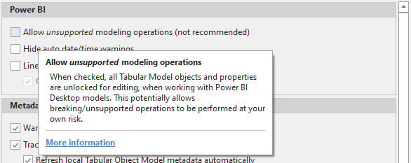
Why limitations with Power BI Desktop
Structure of .pbix file
Can enable, but do not recommend
If you do, always keep a backup of your .pbix file
Microsoft working on Desktop Hardening

Slide 27
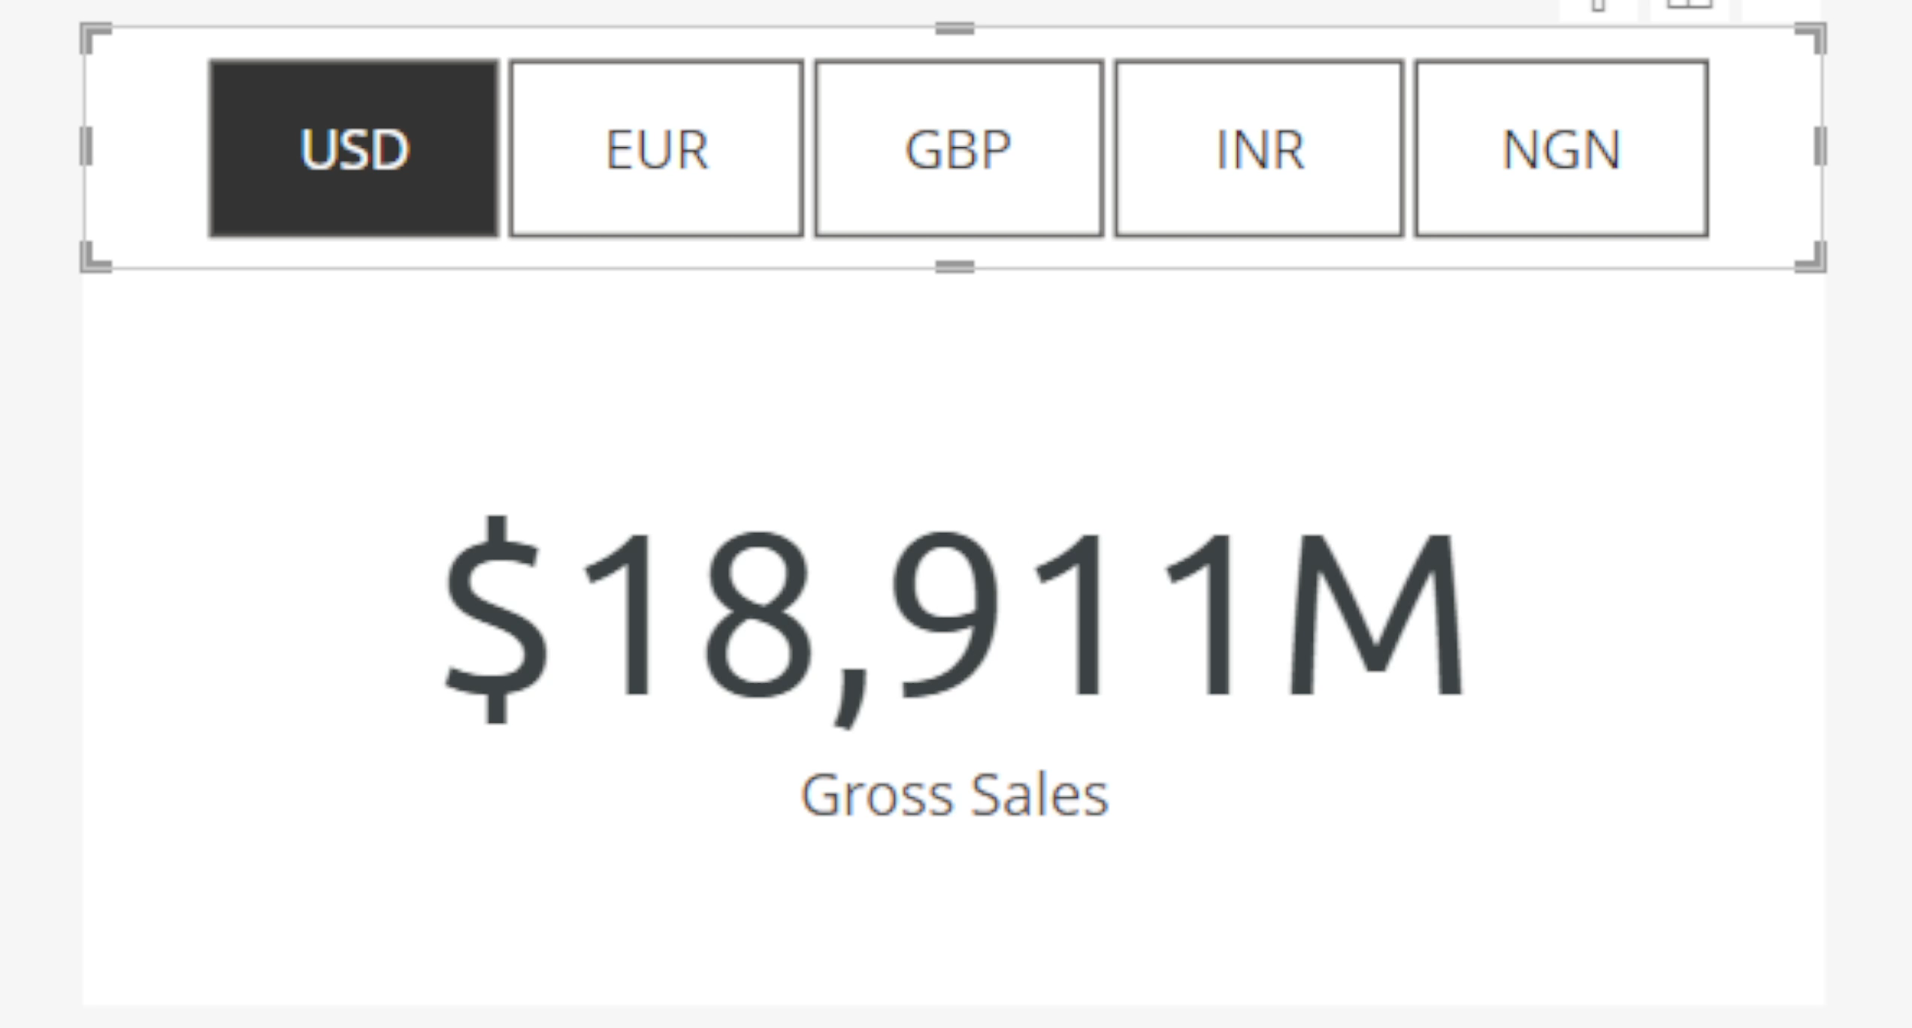


Unlock advanced modeling features
Improve reporting features & flexibility
Calculation Groups

Slide 28
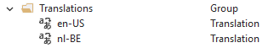
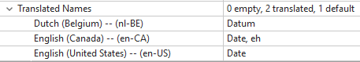

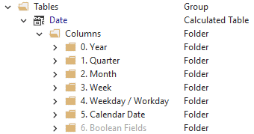
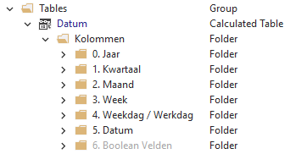
Unlock advanced modeling features
Improve model accessibility
Translations

Slide 29
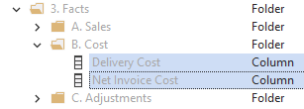


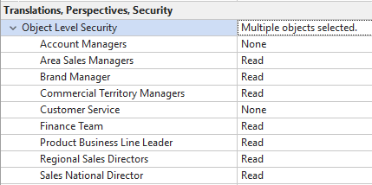



Unlock advanced modeling features
Improve model security
Object-level Security (OLS)
What is Data Security? | Tabular Editor Documentation

Slide 30
Tabular Editor and Power BI Desktop better together
C# Scripting

Slide 31
C# Scripts in Tabular Editor
It is possible to write C# Scripts in Tabular Editor
Advanced Functionality
Programmatic access to:
Model Metadata
Tabular Editor features & functionality

Slide 32
C# Scripts in Tabular Editor
Save C# Scripts as Macros to re-use them from…
Context Menu
Toolbar Buttons
Shortcuts
Enables:
Automation, by running scripts
Scaling, build tailored workflow improvements
New features, extend existing functionalities

Slide 33





What does C# Scripting do? Examples
Scale
Format all
Model DAX
Automate
Scan Datasets
In Power BI
With CLI + BPA
Do More
Format
Power Query
(M Code)
Automate
Create Model Documentation
Scale
Create Measures
& Objects with
IAC-like solutions

Slide 34




Why is this valuable for me?
Reduce development time
Reduce effort on mundane tasks
Scale & create repeatable solutions
Create tailored solutions not in the UI

Slide 35
Process When Writing C# Scripts
Identify opportunity for C# Scripting to bring value
Identify properties, objects etc. needed
Map out a process to script it
Write and test C# / LINQ
Comment and document the C# Script
Save script with version control; configure Macro
1
2
3
4
5
6

Slide 36
Advanced C# Scripting
Sophisticated solutions
Usually integrated with other pipelines, APIs, etc.
Rely on more than ‘Out-of-the-Box’ scripting API functionality

Slide 37


Examples
Format Power Query Partition M Expressions Automatically
Scan datasets using the CLI + Best Practice Analyzer
Automated Testing for CI/CD with DAX Queries
Create Field Parameter Table for Selected Fields

Slide 38
Getting Started
Tabular Editor C# Script Library
PowerBI.Tips Github : PowerBI-tips/TabularEditor-Scripts
Michael Kowalski: Useful code for tabular modeling and automation

Slide 40
Q&A
Become a Power BI data modeling wizard using Tabular Editor 3
Link to session evaluation
https://sqlb.it/?10295

Slide 41
Thank you
Do come see us at our sponsor booth

